Slide 1
Chillers
Chillers
Our team :
Konstantinos Christos Giouroukalis -team leader, physics guy 1
Akis Vogiatzis - physics guy 2
Georgios Lazaridis -app development
Ioannis Digkas -M.L./ data analysis , data visualization
Nikiforos Kliafas -interactive map development/data analysis
CH4
CO2

Slide 2
The Challenge
Greenhouse gasses explained
Uncover the Role of Greenhouse Gases in Your Neighborhood!
Your challenge is to use a combination of satellite and model-based datasets to map both human-caused and natural greenhouse gas emissions to enable better understanding of how these emissions contribute to a warmer world.
Greenhouse gasses allow the intrusion of sun radiation to enter the earth’s atmosphere. At the same time, they do not allow the reflected rays to escape the atmosphere, therefore trapping the radiation, causing global warming.
The two most frequent GHG are CO2 and CH4 together making up 91% of greenhouse gasses.

Slide 3
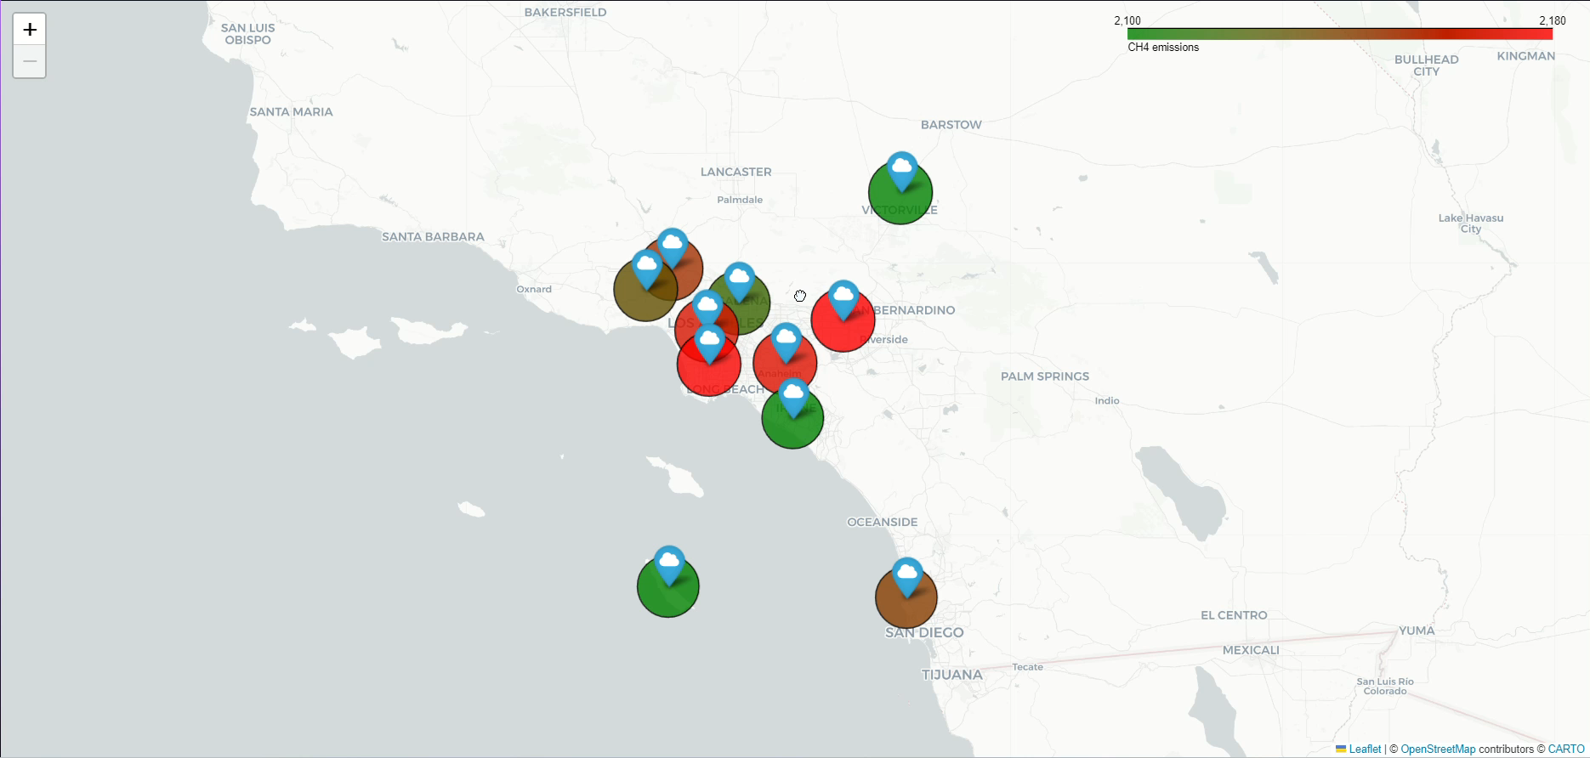
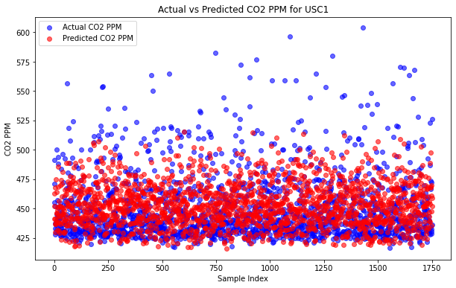
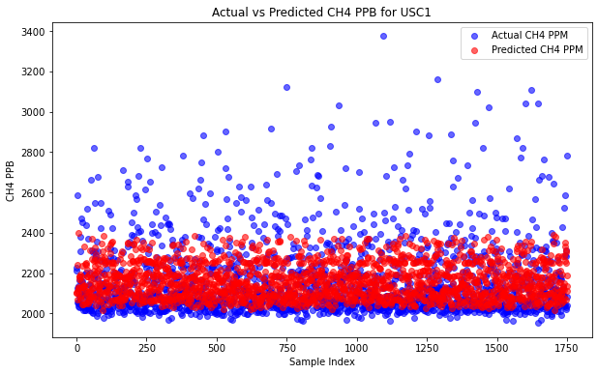
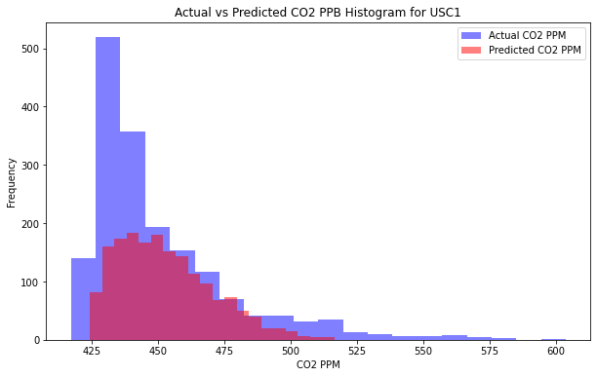
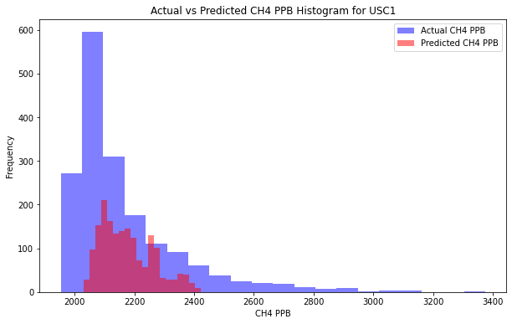
The problem in front of us
Our solution
By gathering data on an interactive map to visualize which areas are most polluted…
And training a neural network with atmospheric station data to predict changes in GHG concentrations…
We believe that as the next generation it is our moral obligation to protect and preserve the environment the best we can. Specifically , each student can have a positive impact on slowing down environmental decay. So we came up with a solution…
In fact the world economic forum states that 70% of gen-z have a strong feeling of empathy regarding the environmental crisis

Slide 4
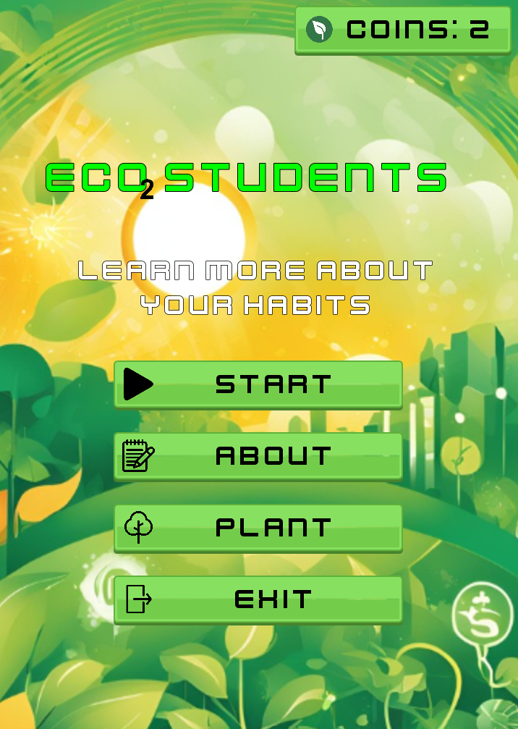
Our solution
…We designed an app that will include not just the two aforementioned features, but also a daily feature where the user will be able to calculate his carbon emissions. This will be done through a selection system with daily actions that tracks your carbon footprint.

Slide 5
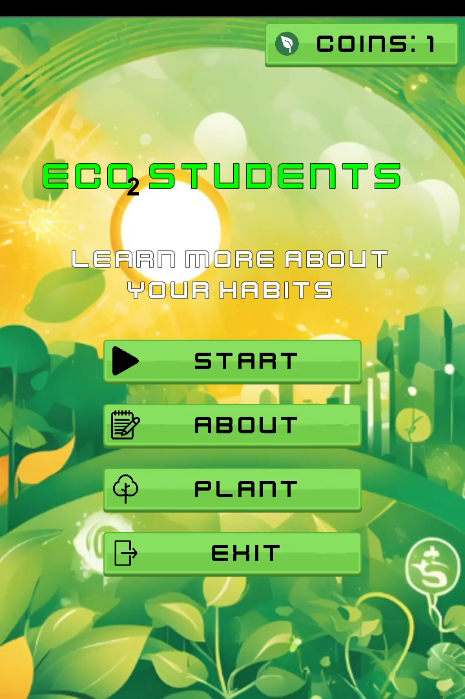
The magic at hand
Why?
The app’s goal
To raise awareness and empathy for the protection of the environment and give a new level of interaction with the issue. Students will now be able to fully contribute by providing data regarding their emissions.
The app has 4 main goals:
Plant as many trees as possible
Inform students with facts regarding the environment
Give feedback to the user and provide tips to improve your carbon footprint
Reward the user according to their daily streak (e.g. discount coupons)

Slide 6
Future improvements
Networking with eco friendly companies and organizations to support the rewarding system
Full integration of the interactive map and the machine learning model, in the app
Create a community for the app’s users where they will have the ability to participate in challenges with others to increase incentive and win prizes
Connect the app with research departments regarding the environment and provide them with data

Slide 7
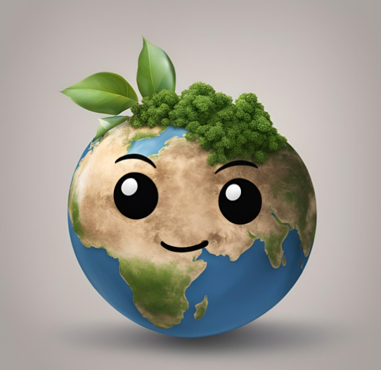
Sources
Thank you for your attention!!
https://freesvg.org/thumbs-up-dog
https://freesvg.org/thumbs-down-dog-remix
https://pngtree.com/so/endangered-animals-clipart
https://earth.gov/ghgcenter/data-catalog/lam-testbed-ghg-concentrations
https://www.youtube.com/watch?v=XFCdxppTsu0
https://www.youtube.com/watch?v=IADrwC_BcVA
https://www.europarl.europa.eu/topics/en/article/20230316STO77629/climate-change-the-greenhouse-gases-causing-global-warming
https://science.nasa.gov/climate-change/faq/what-is-the-greenhouse-effect/
https://deepai.org/machine-learning-model/text2img
https://www.nrdc.org/stories/greenhouse-effect-101#causes
https://www.epa.gov/ghgemissions/overview-greenhouse-gases

